Slide 1
Pet Simulator
Cs665 final project
By Nina Sudheesh

Slide 2
Idea
virtual Pet simulator game
Get to play and take care of virtual pet
Inspired from my little kid cousins
I used 3 pattern - Builder and Command and State

Slide 3
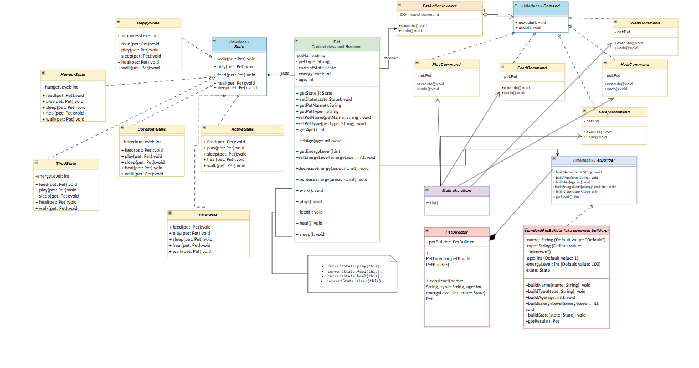
UML

Slide 4
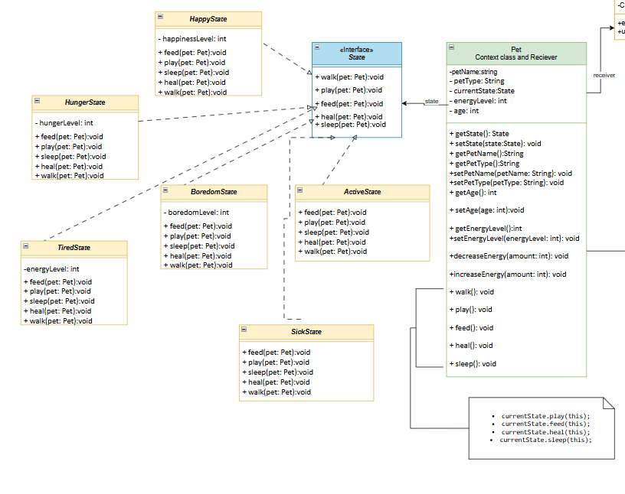
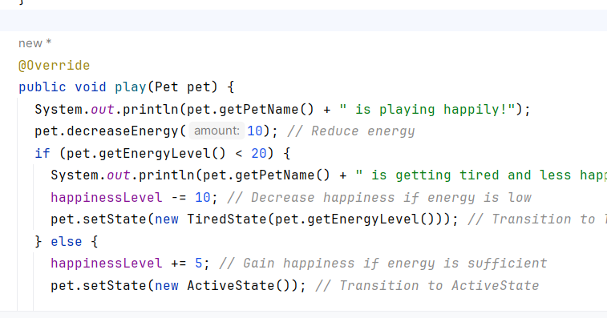
1/3 Patterns i used
State pattern
Different states of pet reaction to different activities or task
models dynamic behaviors that depend on the pet's current state. For example, a "Happy" pet may have different responses to actions like play or feed than a "Tired" or "Hungry"
5 different states of pet

Slide 5
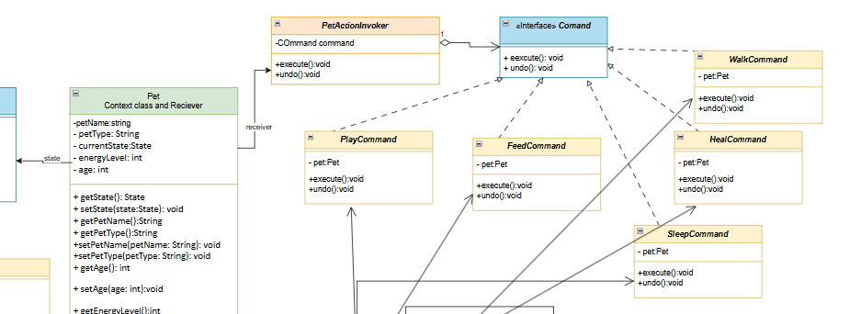
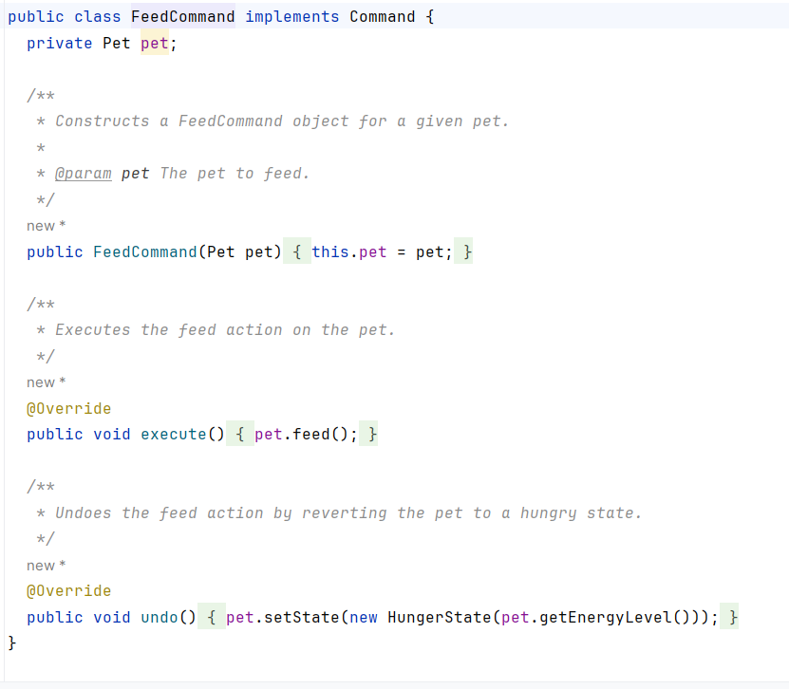
⅔ Patterns i used
Command pattern
Encapsulate a request as an object, thereby letting you parameterized action so that you can have different commands user can perform with a pet so
Such as WalkCommand or FeedCommand PlayCommand SleepCommand
New actions (e.g. TrainCommand) can be added as separate command classes without altering the existing one
UNDO functionality support
5 commands

Slide 6
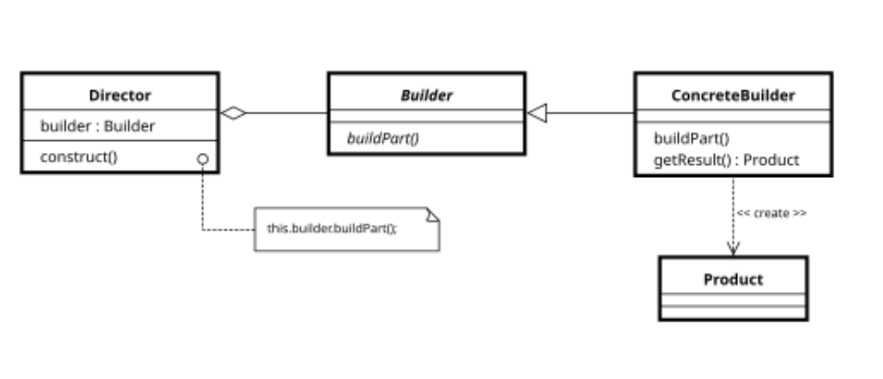
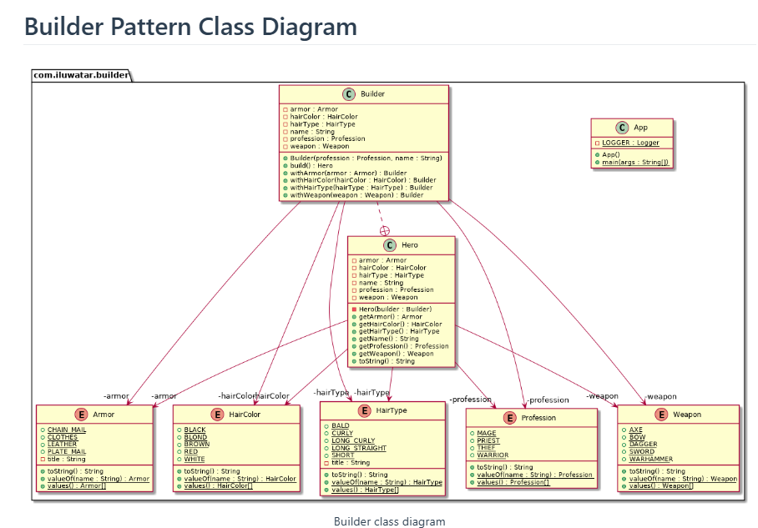
Builder pattern
you create complex objects step by step, without worrying about how they will look at first.
The same process can be used to create different versions of the object by changing the details during the process..
When object involves many parameters or is too complex for a single constructor
Sample Builder uml

Slide 7
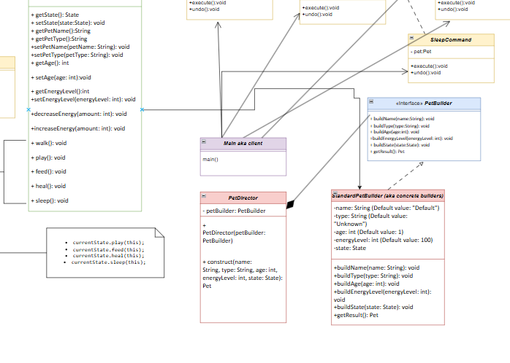
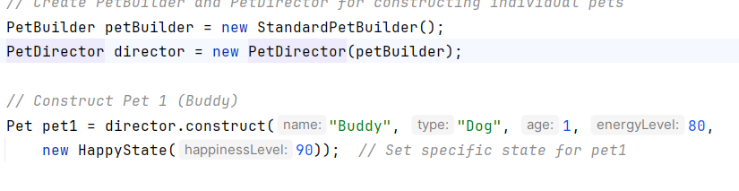
Builder pattern
Builder pattern
Created petbuilder interface
Defines method implement by StandardPetbuilder
PetDirector using a PetBuilder to construct a Pet object.

Slide 8
Demo

